Slide 1
Lecture 12

Slide 2
Lecture 12 objectives
Understand and apply protein detection techniques
Apply principles to purify proteins

Slide 3
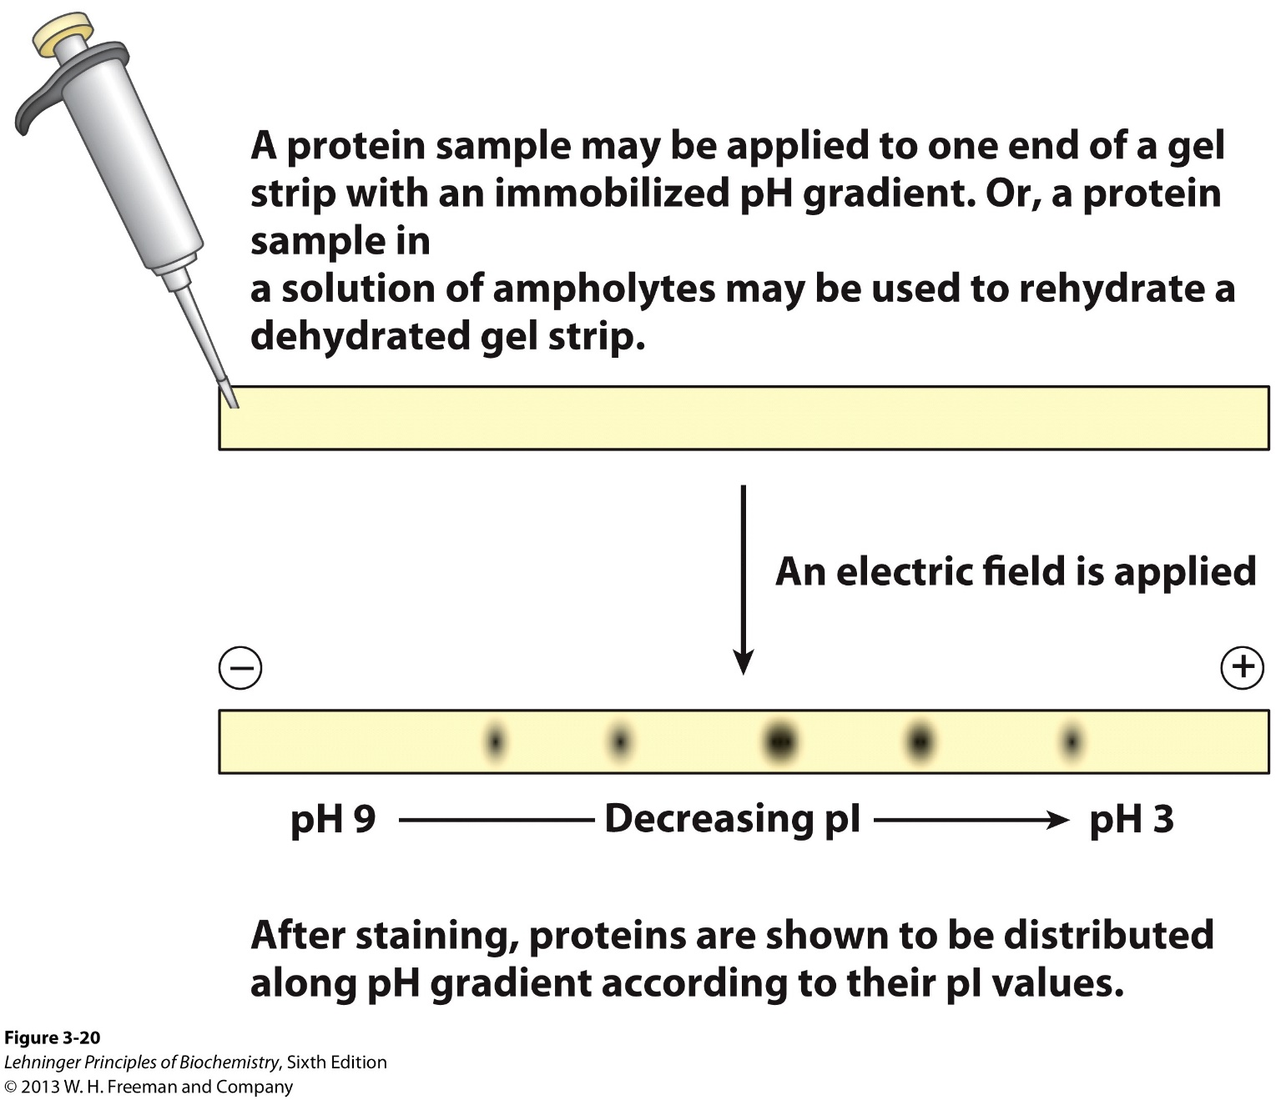
Separating & detecting: Isoelectric focusing

Slide 4
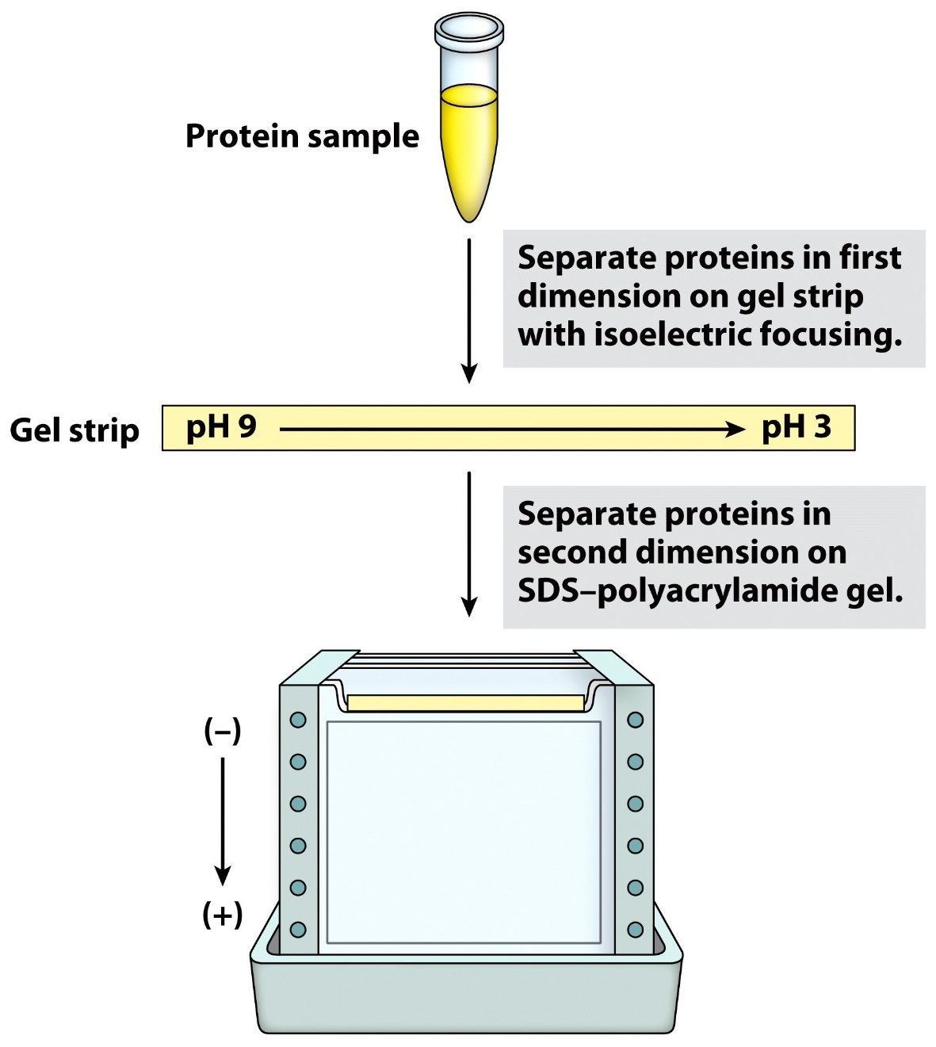
2D Gel Electrophoresis

Slide 5
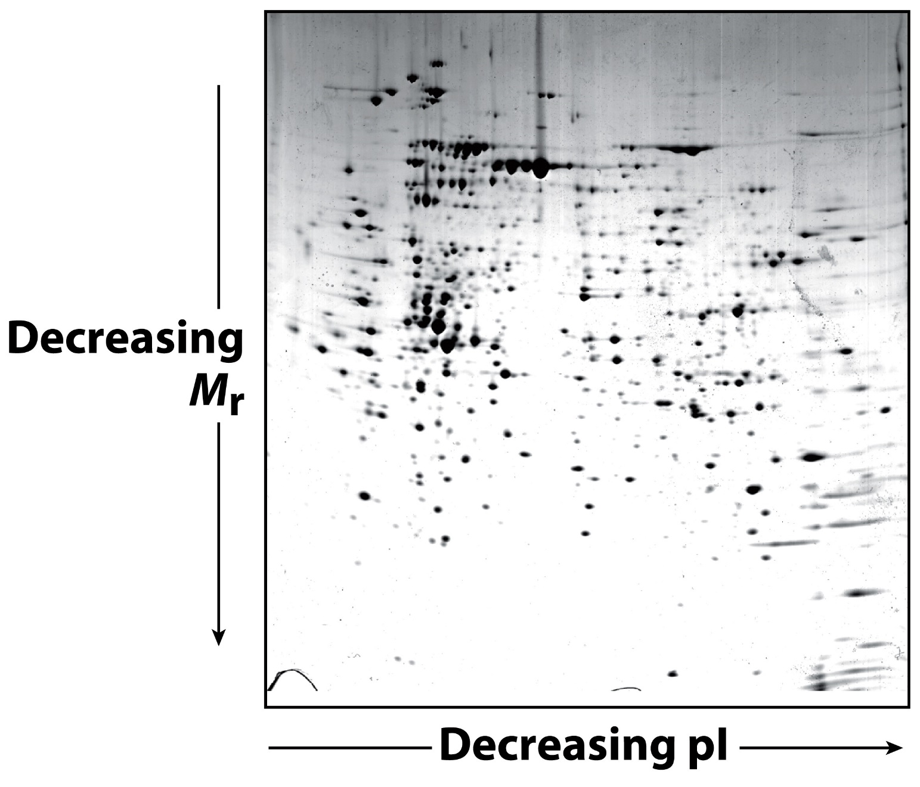
2D Gel Electrophoresis

Slide 6
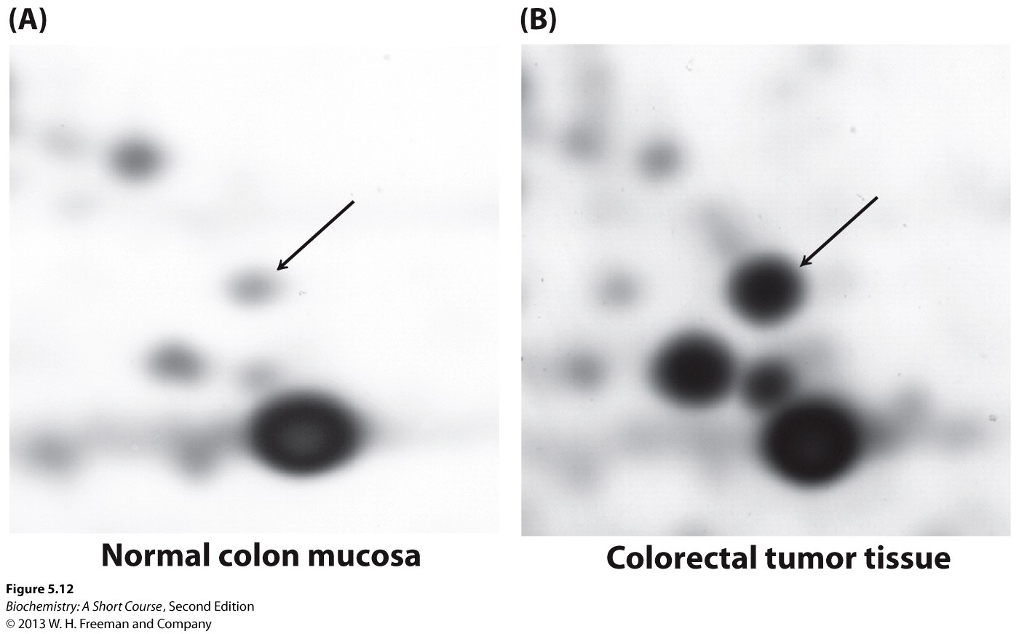
Differences in the “proteome”

Slide 7
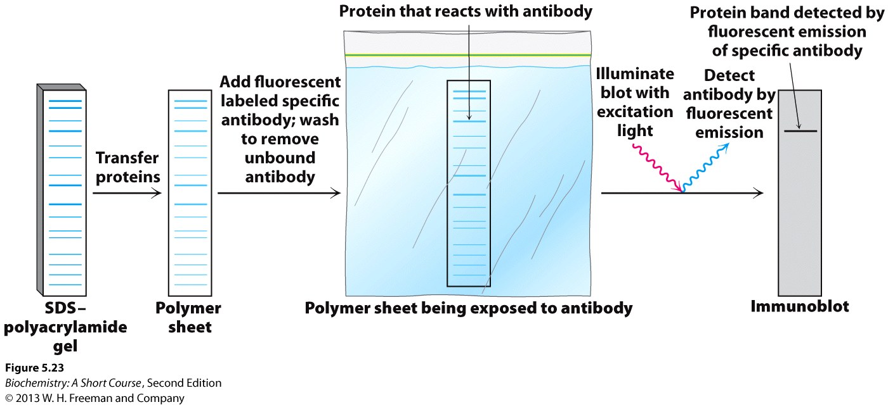
“Western” Blots

Slide 8
“Western” Blots

Slide 9
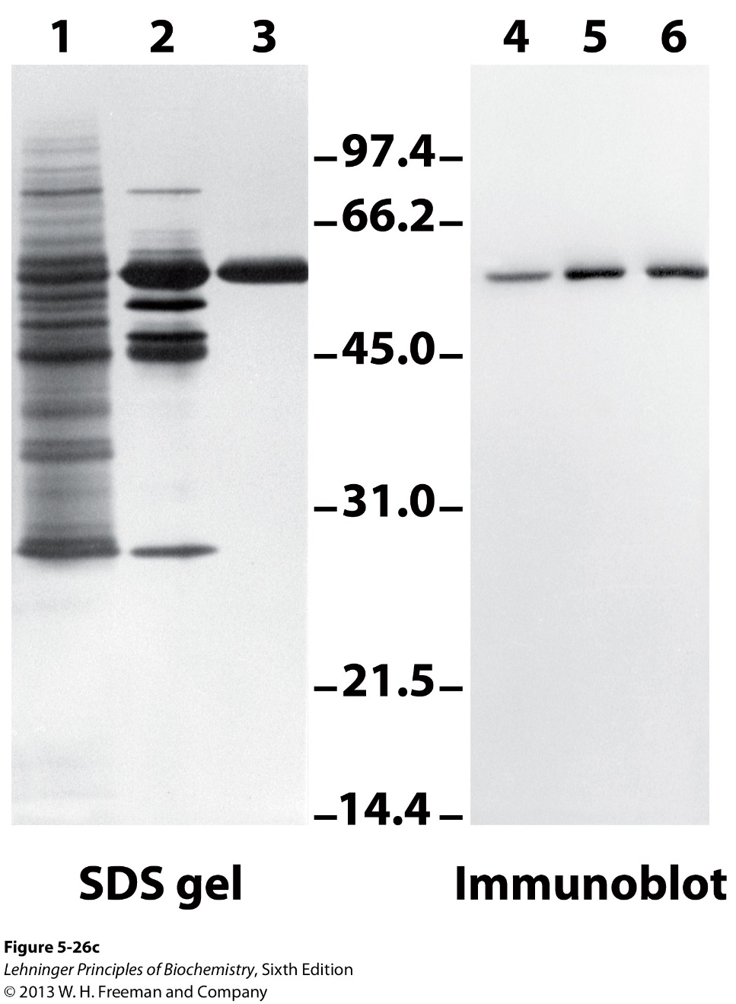
“Western” blots from PAGE gels

Slide 10
General protein sequencing principles
Cut into peptides using different reagents – WHY?
Identify amino acids of each peptide fragment

Slide 11
General protein sequencing principles
???

Slide 12
General protein sequencing principles

Slide 13
General protein sequencing principles
Cut into peptides using different reagents – WHY?
Identify amino acids of each peptide fragment
Assemble sequence

Slide 14
Purifying proteins. Putting it all together…
Known about protein of interest:
Present in lysosome
Lys-rich, ~56 KD in size, highly soluble
Catalyzes degradation of proteins
Only protein in lysosome that breaks disulfide bridges
Have a protein substrate as shown
Disulfide bridge
Draw out a step-wise purification flow chart

